Slide 1
NextJS Sharing
May 2023

Slide 2
Introduction
Purpose
What is NextS ?
Showcase
NextJS Router
Page Router
App Router
NextJS Rendering (Page Router)
Pre-rendering & Hydration
Client-Side Rendering
Server-Side Rendering
Static Side Generate
Without Data
Page Content
Page Path
Increment Mentail Rendering
Revalidate
Generate On-Demand
Per-page Basis
Compare Between Rendering Types
NextJS with SEO
Q&A

Slide 3
01
Introduction

Slide 4
Purpose
What
Why
How
How does NextJS work ?
What is NextJS ?
Why is NextJS a popular react framework to build for SEO and more ?

Slide 5

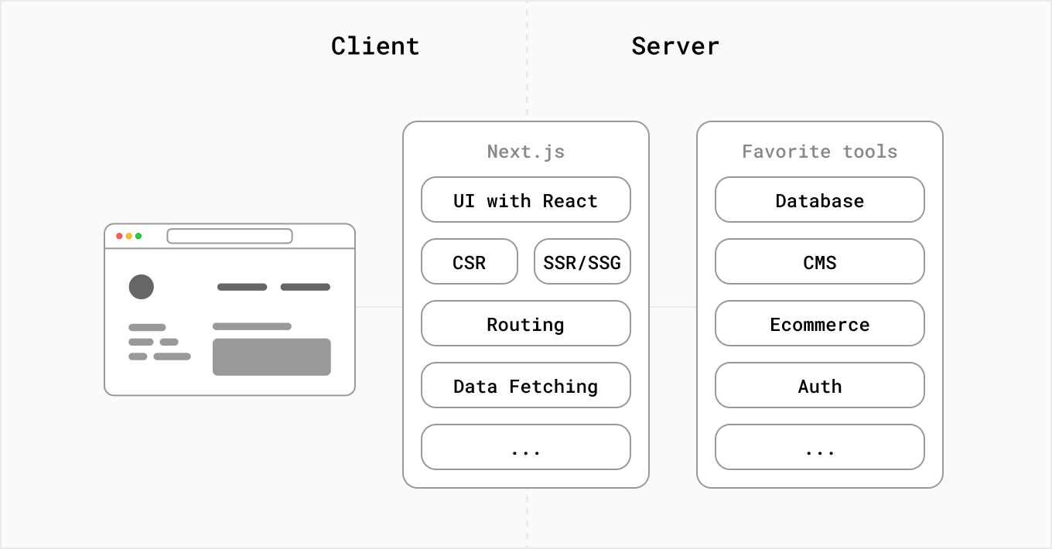

What is NextJS ?
NextJS is a React framework for the Web.
All the tools you need to make the Web. Faster.
https://nextjs.org/

Slide 6
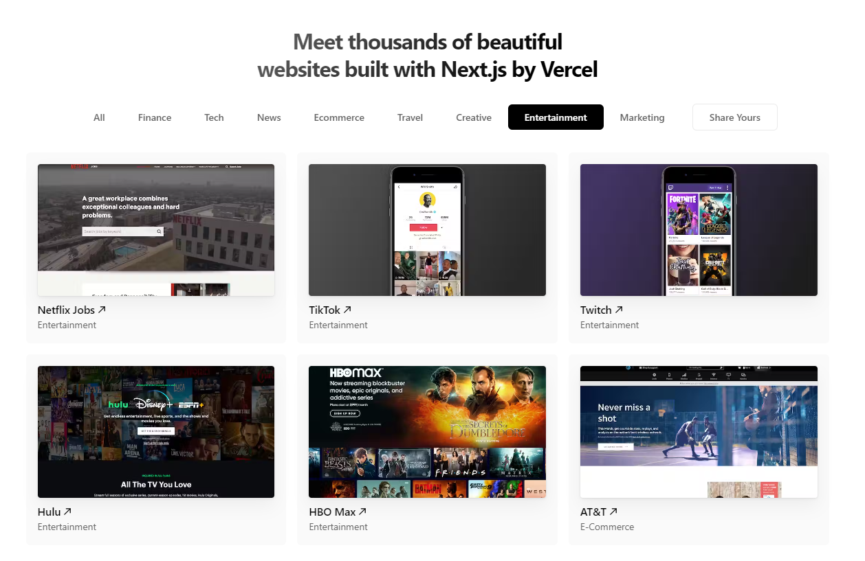
Showcase
https://nextjs.org/showcase

Slide 7
02
NextJS Router

Slide 8
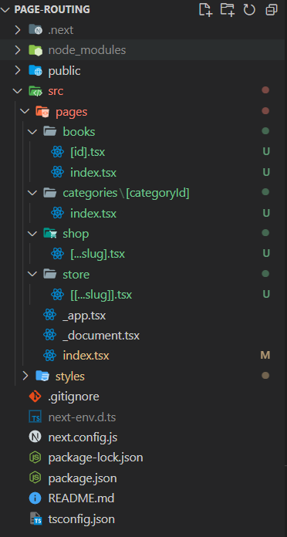
Page Router
In Next.js, a page is a React Component exported from a file in the pages directory.
Pages are associated with a route based on their file name. For example, in development:
pages/index is associated with the / route. (localhost:3000)
pages/posts/first-post is associated with the /posts/first-post route. (localhost:3000/posts/first-post)
There are 4 types of page router :
String Parameter
page/books/index.tsx => Match localhost:3000/books
Dynamic Segment
page/books/[id].tsx => Match localhost:3000/books/1 && localhost:3000/books/1
page/categories/[categoryId]/index.tsx => the same above
Catch-all Segments
page/shop/[…slug].tsx => Match localhost:3000/shop/1/1 && localhost:3000/shop/1/2
page/shop/[…slug].tsx => Not Match localhost:3000/shop
Optional Catch-all Segments
page/shop/[[…slug]].tsx => Match localhost:3000/shop/1/1 && localhost:3000/shop/1/2
page/shop/[[…slug]].tsx => Match localhost:3000/shop

Slide 9
App Router
The App Router is a new paradigm for building applications using React's latest features. If you're already familiar with Next.js, you'll find that the App Router is a natural evolution of the existing file-system based router in the Pages Router.
https://nextjs.org/docs/app (More Detail)

Slide 10
03
NextJS Rendering
(Page Router)

Slide 11
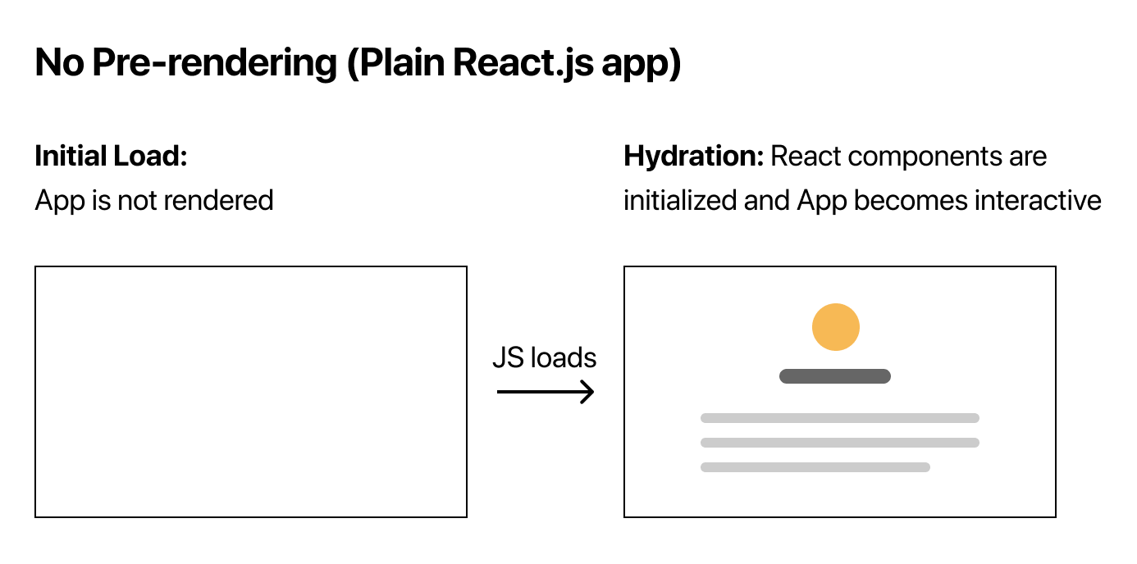
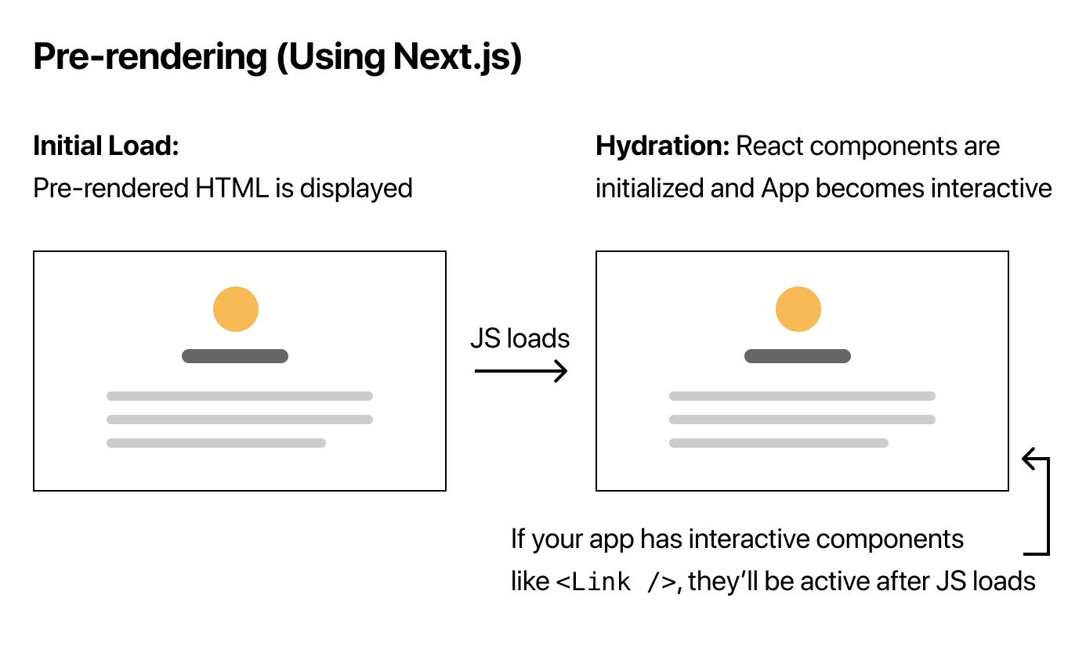
Pre-rendering & Hydration
Next.js generates HTML for each page in advance, instead of having it all done by client-side Javascript. (This is called Pre-rendering) => Pre-rendering can result in better performance and SEO
Each generated HTML is associated with minimal Javascript code necessary for that page. When a page is loaded by the browser, its Javascript code runs and makes the page fully interacetive. (This process is called hydration)

Slide 12
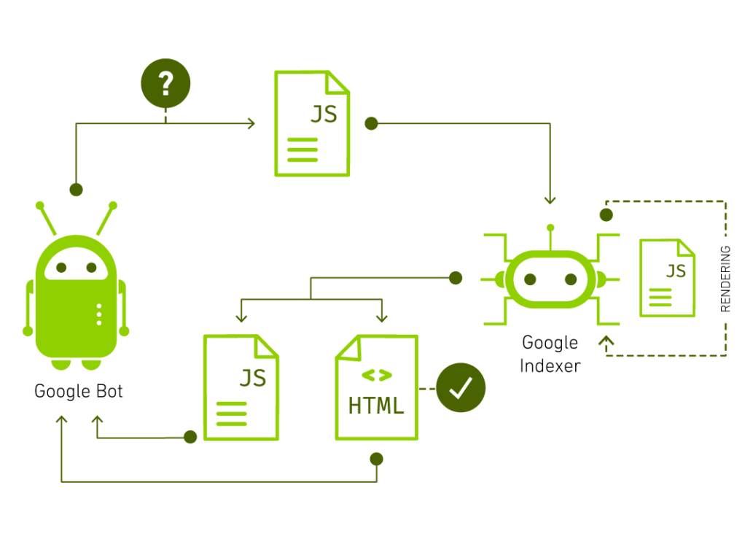
Pre-rendering & Hydration
Why does Next.js generate HTML for each page in advance, instead of having it all done by client-side Javascript ?
Pre-rendering can result in better performance and SEO
More Detail: https://www.apexon.com/blog/next-js-a-development-framework-for-scalability-and-production/

Slide 13
Rendering
STT | Rendering | Data Fetching
1 | Client-Side Rendering (CSR) | useEffect
2 | Server-Side Rendering (SST) | getServerSideProps
3 | Static Site Generation (SSG) | getStaticPaths + getStaticProps (without revalidate)
4 | Incremental Static Regeneration (ISR) | getStaticPaths + getStaticProps (with revalidate)

Slide 14
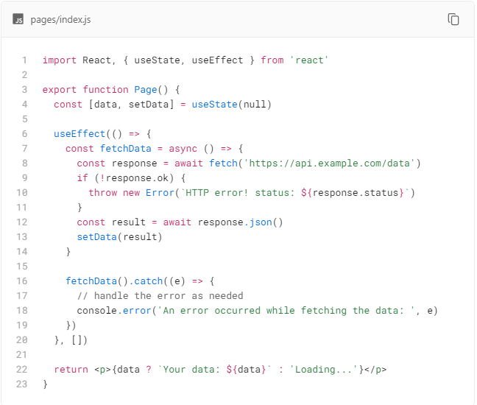
Client-Side Rendering (CSR)
In Next.js, there are two ways you can implement client-side rendering:
Using React's useEffect() hook inside your pages instead of the server-side rendering methods (getStaticProps and getServerSideProps).
Using a data fetching library like SWR or TanStack Query to fetch data on the client (recommended).

Slide 15
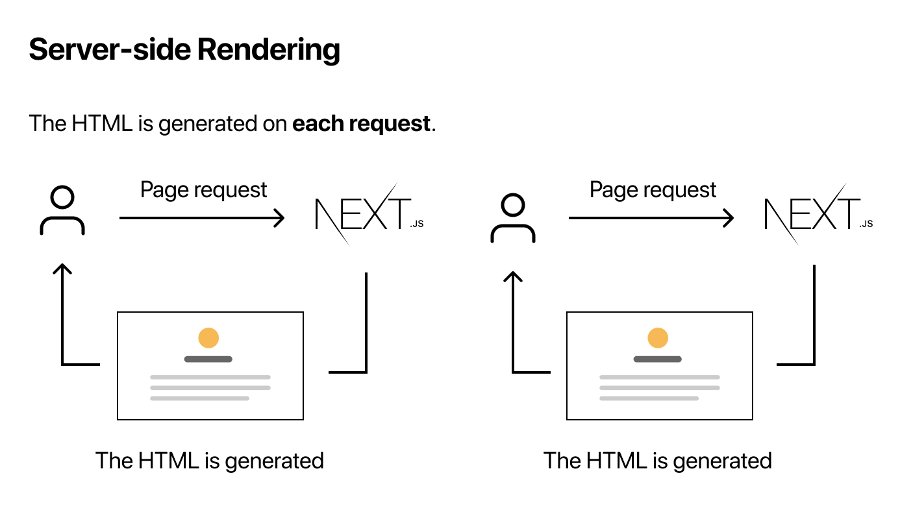
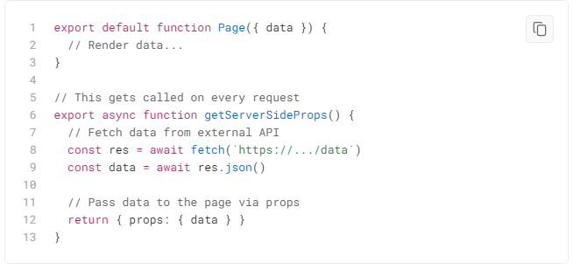
Server-Side Rendering (SSR)
If a page uses Server-side Rendering, the page HTML is generated on each request. (Note: for Client-side Rendering is not re-generated on each request)
To use Server-side Rendering for a page, you need to export an async function called getServerSideProps. This function will be called by the server on every request.
For example, suppose that your page needs to pre-render frequently updated data (fetched from an external API). You can write getServerSideProps which fetches this data and passes it to Page like below:

Slide 16
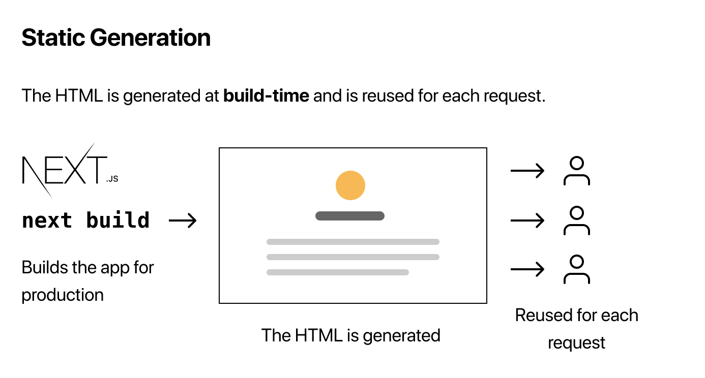
Static Site Generation (SSG)
If a page uses Static Generation, the page HTML is generated at build time. That means in production, the page HTML is generated when you run next build. This HTML will then be reused on each request. It can be cached by a CDN.
There are 3 scenarios:
Without external data
Page data content depends on external data
Page data paths depends on external data

Slide 17

SSG without external data
This page does not need to fetch any external data to be pre-rendered. In cases like this, Next.js generates a single HTML file per page during build time.

Slide 18
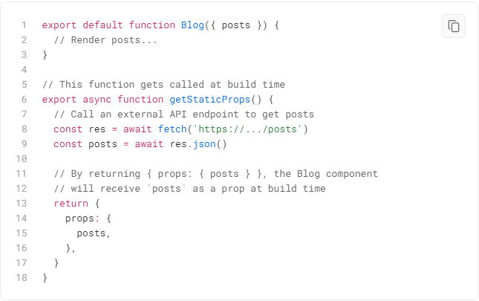
SSG and page data content depends on external data
To fetch this data on pre-render, Next.js allows you to export an async function called getStaticProps from the same file. This function gets called at build time and lets you pass fetched data to the page's props on pre-render.

Slide 19
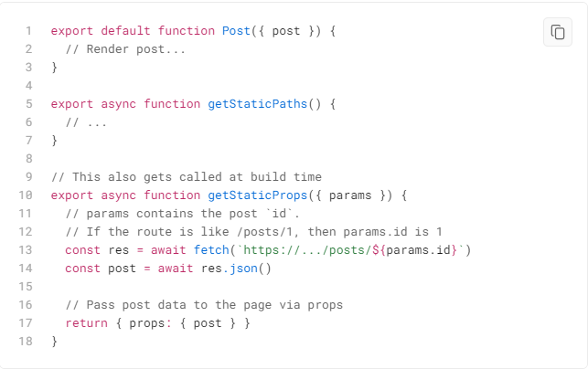
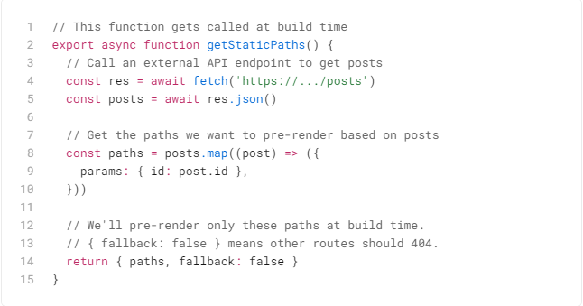
SSG and page data path depends on external data
So your page paths that are pre-rendered depend on external data**.** To handle this, Next.js lets you export an async function called getStaticPaths from a dynamic page (pages/posts/[id].js in this case). This function gets called at build time and lets you specify which paths you want to pre-render.

Slide 20
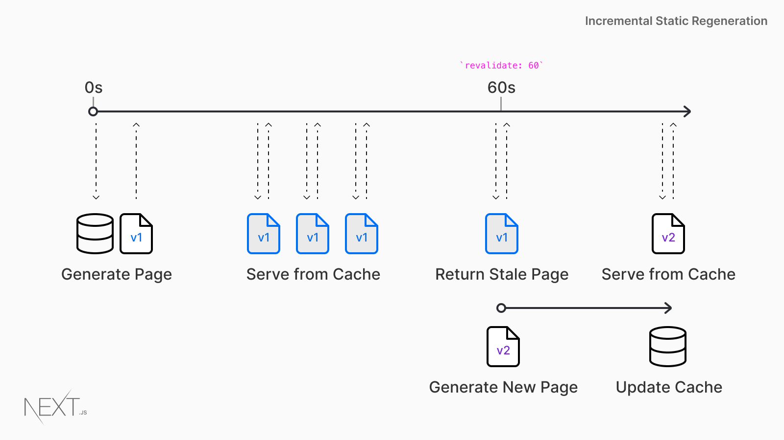
Increment Mentail Rendering (Revalidate)
Next.js allows you to create or update static pages after you’ve built your site. Incremental Static Regeneration (ISR) enables developers and content editors to use static-generation on a per-page basis, without needing to rebuild the entire site
More Detail: https://www.smashingmagazine.com/2021/04/incremental-static-regeneration-nextjs/

Slide 21
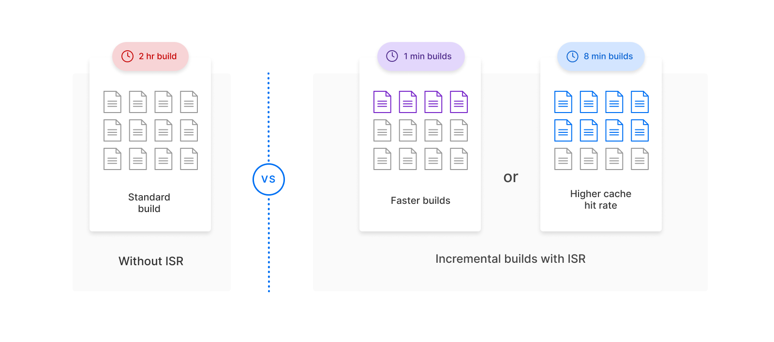
Increment Mentail Rendering (Gerenated On-Demand)
With ISR, you can retain the benefits of static while scaling to millions of pages.
Because Static pages can be generated at runtime (on-demand) instead of at build-time.
More Detail: https://www.smashingmagazine.com/2021/04/incremental-static-regeneration-nextjs/

Slide 22
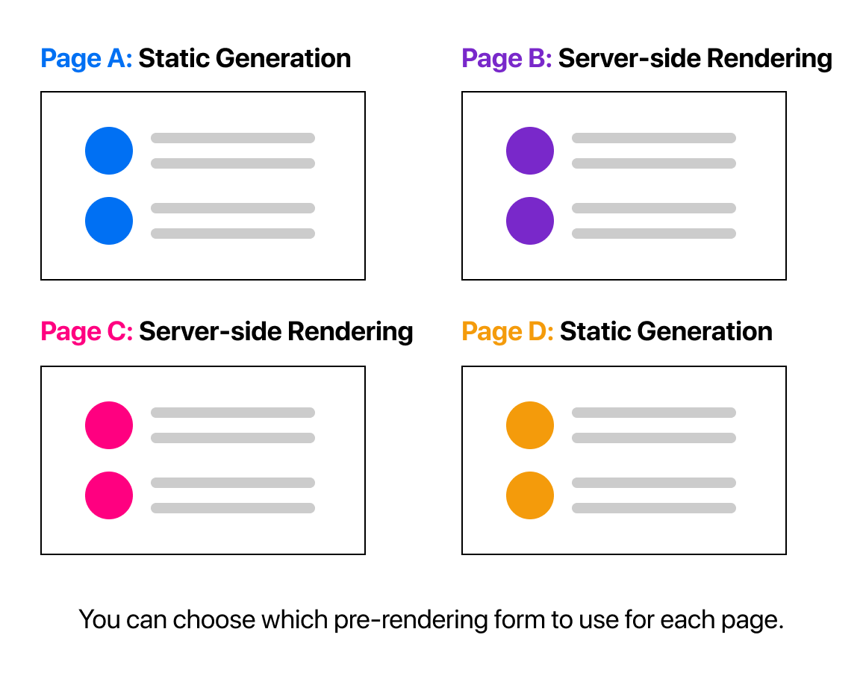
Per-page Basis
Importantly, Next.js lets you choose which pre-rendering form to use for each page. You can create a "hybrid" Next.js app by using Static Generation for most pages and using Server-side Rendering for others.

Slide 23
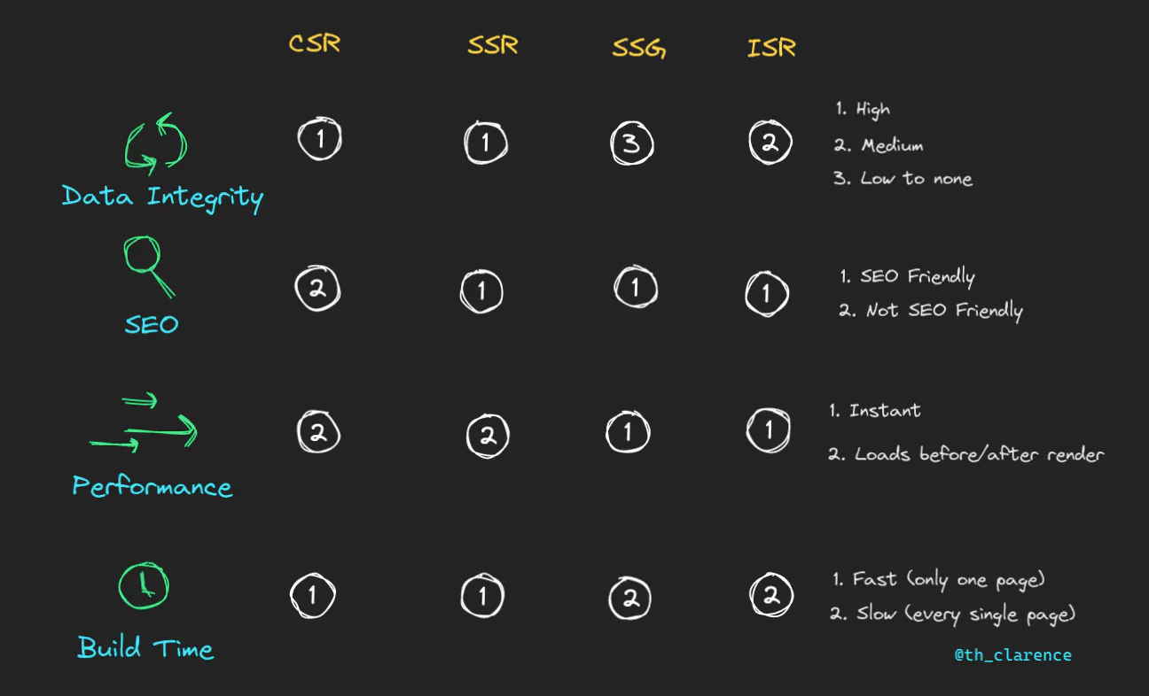
Compare Between Rendering Types
More Detail: https://theodorusclarence.com/blog/nextjs-fetch-usecase

Slide 24
04
NextJS SEO

Slide 25
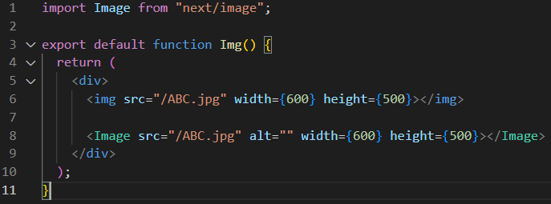
Image Optimazation
The Next.js Image component extends the HTML <img> element with features for automatic image optimization:
Size Optimization: Automatically serve correctly sized images for each device, using modern image formats like WebP and AVIF.
Visual Stability: Prevent layout shift automatically when images are loading.
Faster Page Loads: Images are only loaded when they enter the viewport using native browser lazy loading, with optional blur-up placeholders.
Asset Flexibility: On-demand image resizing, even for images stored on remote servers
More Detail: https://www.youtube.com/watch?v=IU_qq_c_lKA

Slide 26
Font Optimization
More Detail: https://blog.logrocket.com/next-js-font-optimization-custom-google-fonts/

Slide 27
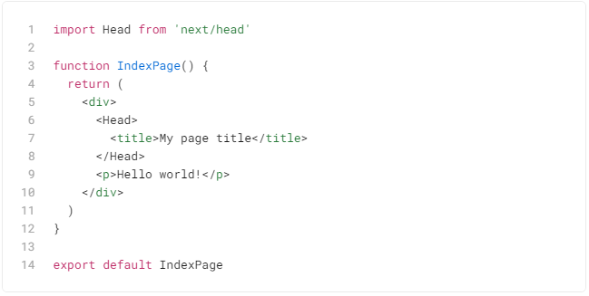
Head Component
The Head Component in Next.js is designed to allow you to easily include all of the HTML elements that you want included in the <head> element for a given HTML element.
We can make each pages with difference title, meta tags, charset, author, viewport settings, etc.
All these tags help to provide information about the website to Google. Google ranks your website by using this information. That is why the Head component is considered SEO friendly.
More Detail: https://blog.logrocket.com/next-js-font-optimization-custom-google-fonts/

Slide 28
04
Other

Slide 29
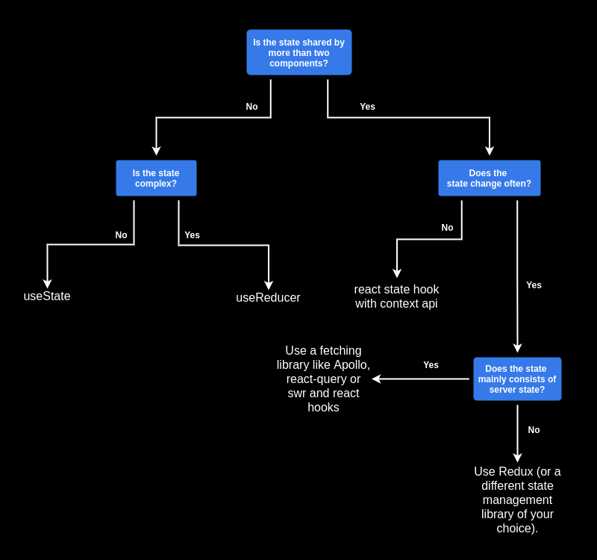
useSWR
https://swr.vercel.app/

Slide 30
NextJS with Proxy

Slide 31
NextJS Authentication

Slide 32
Lazy Loading

Slide 33
05
Q&A

